Slide 1
PROJECT : HOSPITAL MANAGEMENT SYSTEM
PROJECT BY : PRAMOD SADAPHULE
pramodsadaphule01@gmail.com
Hospital Management System (HMS) –
A Hospital Management System is software designed to manage all the operations of a hospital efficiently. It helps in handling patient details, doctor information, appointments, billing, and medical records in a systematic way.
Key Functions:
Patient registration and record management
Appointment scheduling
Doctor and staff management
Pharmacy and laboratory management
Billing and payment handling
Report generation and data analysis
Advantages:
Saves time and reduces errors
Provides quick access to patient data
Improves hospital efficiency
Enhances coordination among departments
Conclusion:
The Hospital Management System plays an essential role in modern healthcare by digitizing hospital and ensuring accurate, fast, and reliable management of all hospital activities.

Slide 2
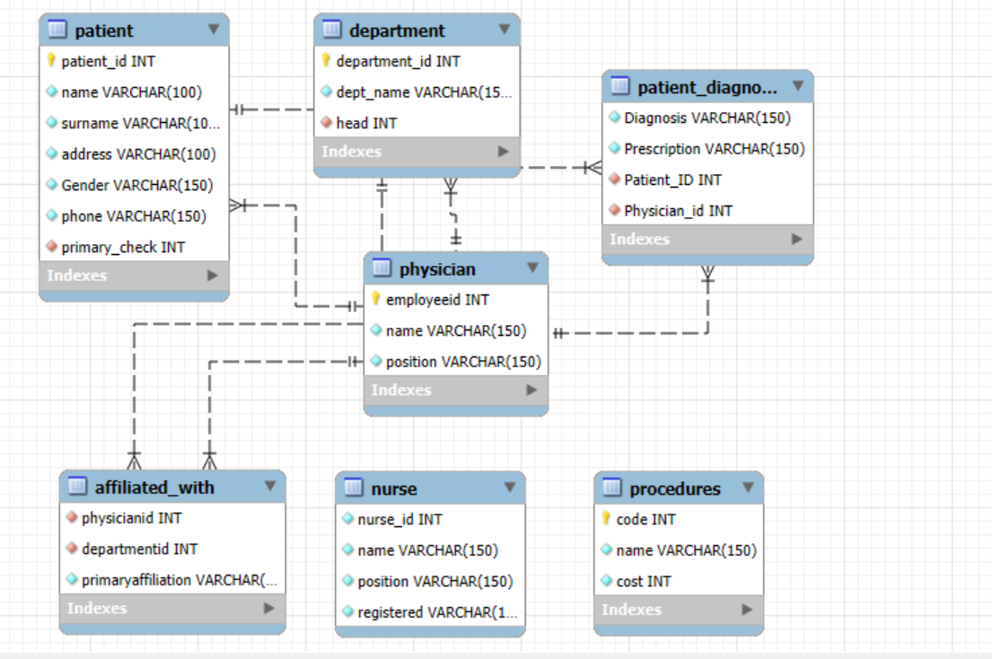
This database contains 7 tables:
1. Physician
Affiliated with
Department
Nurse
Patient
Patient Diagnosis
Procedures

